Slide 1
DS 7333 – Quantifying the World
Live session - 1
Course Introduction & Overview

Slide 2
Welcome to Quantifying the World
Brief Bio
Despite having (2) Masters’ degrees, I am not a doctor – please feel free to refer to me simply as “Brad” throughout this course.
In addition to being an Adjunct Professor with SMU’s Data Science program, I am a full-time employee of PwC, where I serve as a Director within our PwC Intelligence organization, and an independent data science consultant authorized to perform “outside activities.”
Most importantly, I am a husband and father and have firsthand experience “having a family” while working and attending school full-time.
“My name is Brad Blanchard, and I will be your Quantifying the World professor.”

Slide 3












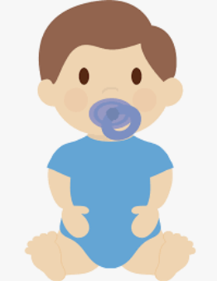

About Me
Education
Work
Family
Count
2
4
6
8

Slide 4
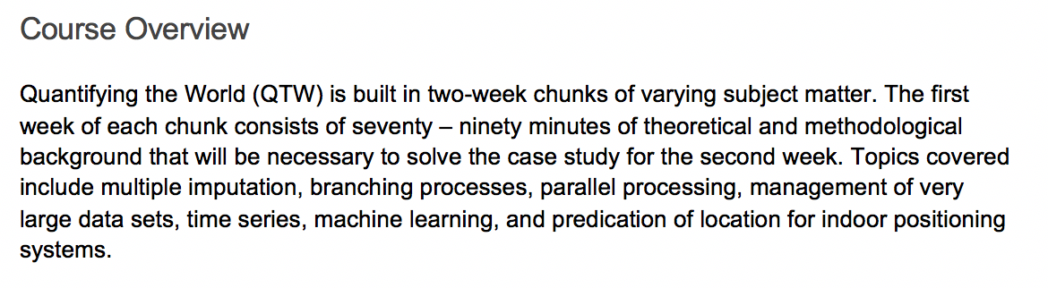
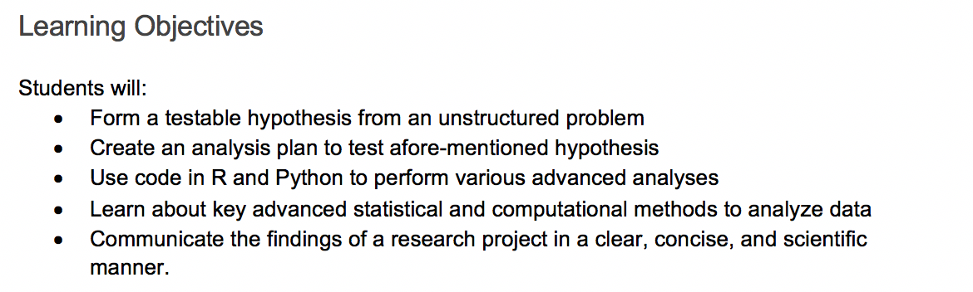
Course Overview & Objectives
Quick Notes:
All Video Lectures have been pre-recorded by Dr. Monnie McGee and Dr. Daniel Engels, who developed the course at SMU
All questions related to the course materials, syllabus, and grading should be sent to (bablanchard@smu.edu) where I will respond within 24-hours
I’m here to help – but I can’t help if you don’t ask – do not be shy!
Every detail of the course can be found in the Syllabus – please read it.

Slide 5
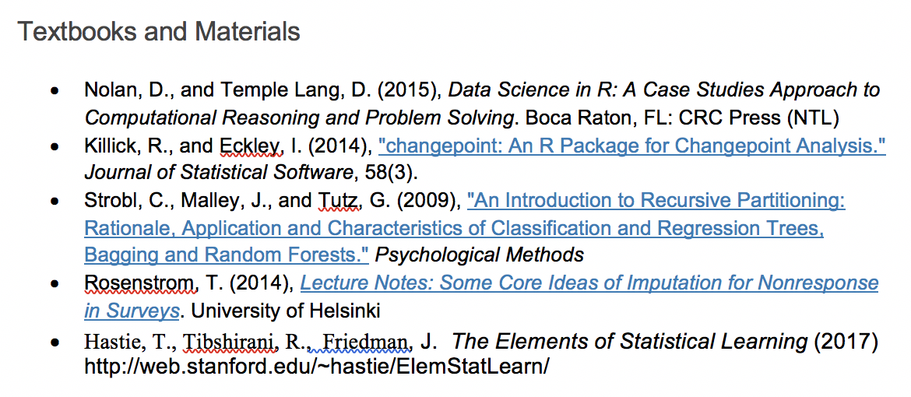
Textbooks & Materials
Quick Notes:
We will be leveraging the “Data Science in R” textbook heavily for the first (3) Case Studies
For the first (3) Case Studies, supplemental material can be found at http://www.rdatasciencecases.org/

Slide 6
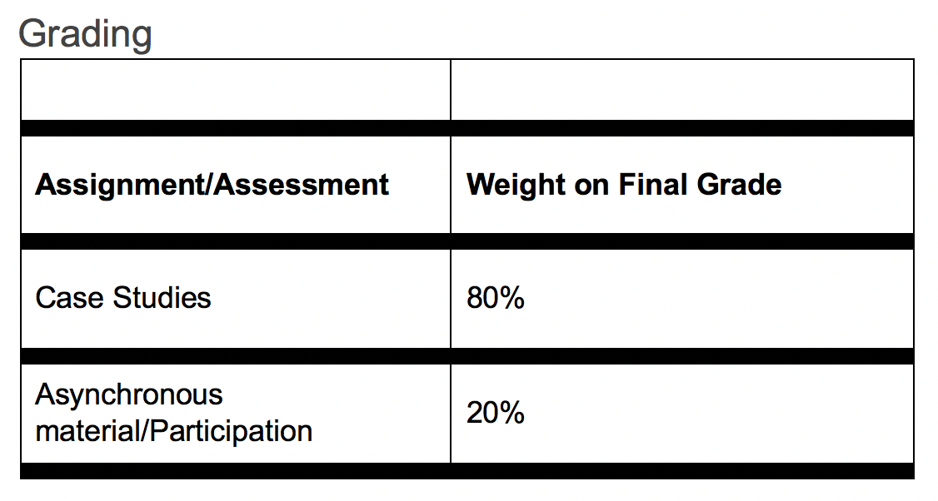
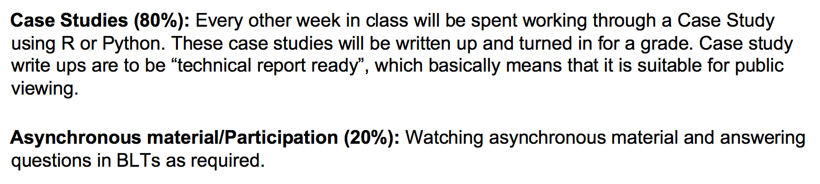
Assignments & Grading
Quick Notes:
All assignments can (and should) be completed in groups
You are welcome to change groups throughout the course – just be sure to list all contributors at the top of your submission
Quizzes in the asynch material will not be graded (so don’t worry) – I will only be observing if you watched and completed the asynch material

Slide 7
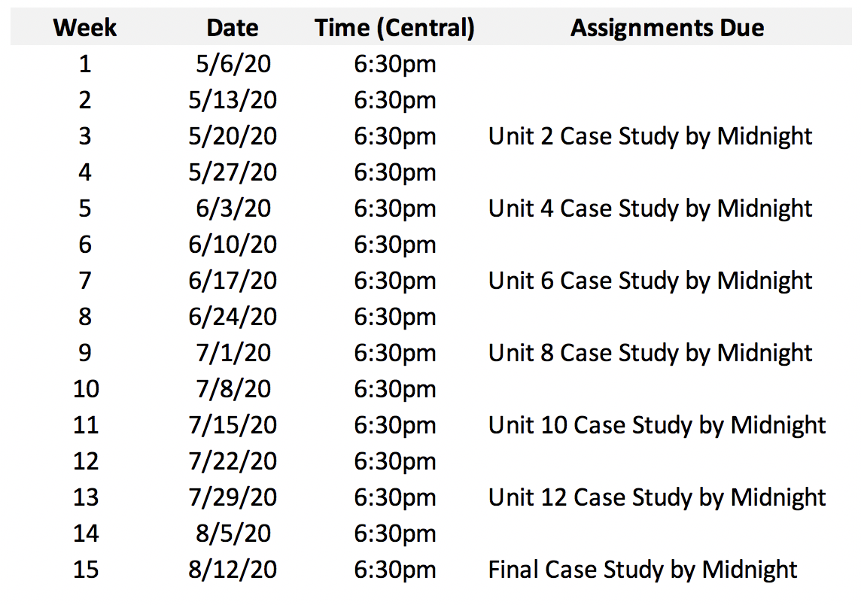
Course Calendar
Quick Notes:
All meetings have been scheduled in 2DS and can be accessed through the “Meetings” section
The Units 2, 4, and 6 Case Studies will align with the first (3) case studies found at http://www.rdatasciencecases.org/ (Geolocation, Cherry Blossom Runners, and Spam)
The Final Case study is worth double

Slide 8
Group Grading
I reserve the right to assign individual grades to group members when there is adequate evidence of unequal contributions amongst team members
I will work to provide clear grading feedback with each submission; however, please note that more exhaustive feedback can come through an individual or team Zoom meeting (please feel free to reach out to me should you want to have a more thorough discussion).
Note that this field seldom has “right or wrong” answers – often there are more or less efficient ways to solve a problem. Said another way, these submissions can be subjective in-nature – my grading may be evident of that reality.
Quick Notes:
I will allow you to form your own groups of up to 4 members
Please attempt to address group issues amongst yourselves before inviting me into the conversation
You are free to change groups throughout the course; just note contributors at the top of each submission

Slide 9
Contact Information
Please contact me at anytime through my SMU email address:
bablanchard@smu.edu
I will reply to all emails within 24-hours of their receipt (and within hours in most circumstances), however, to assist me in monitoring course-related emails, please add the below prefix to the Subject Line of all emails:
DS 7333 Student – [Additional Subject Context Here]
All meetings and office hour interactions will take place over Zoom.
Quick Notes:
For security and privacy, I will not be providing you with my personal cell phone number
I will make every effort to monitor my inbox more closely leading up to Project submission deadlines in the event you have an urgent issue
I will plan to be available for 30-minutes after each Live Session to assist with any immediate questions you may have or personal matters you may be working through

Slide 10
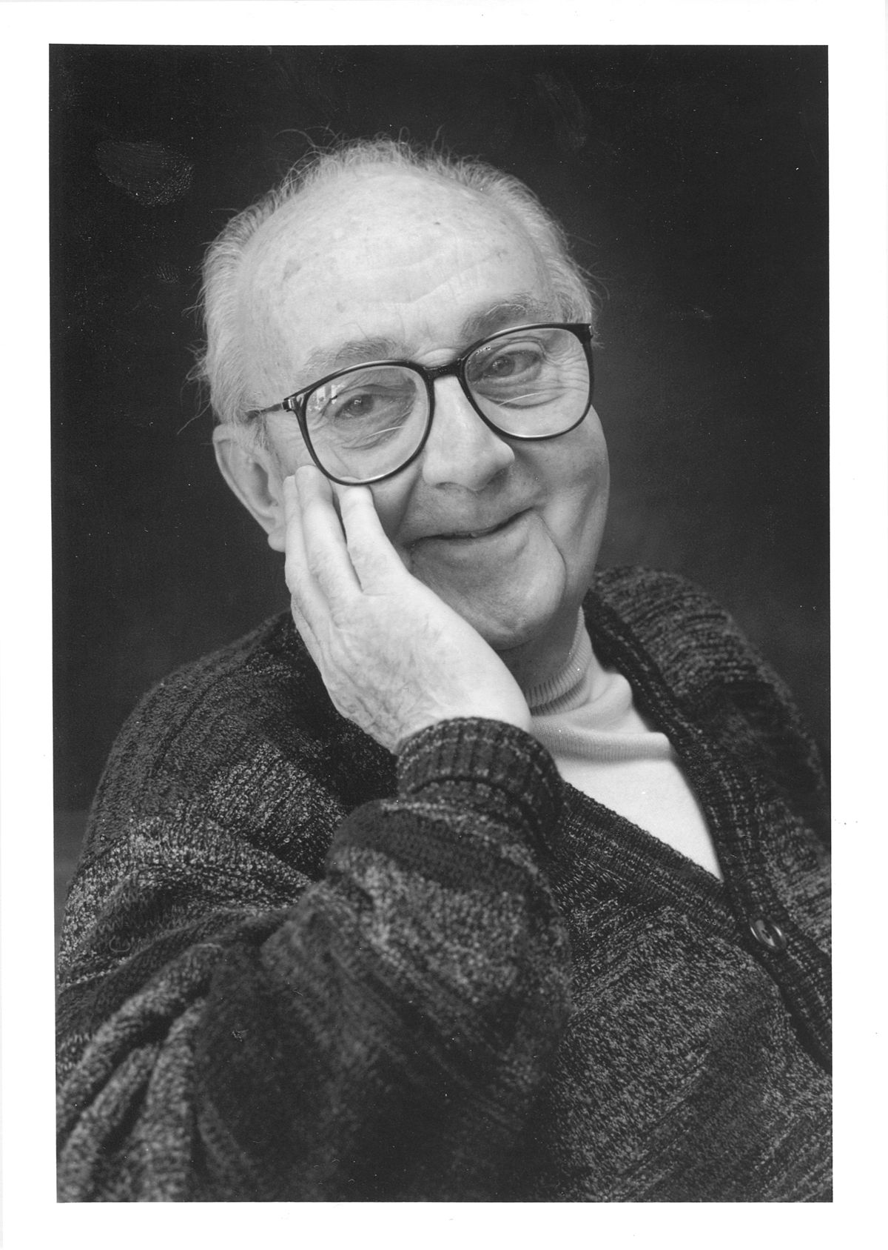
Final Words
“All models are wrong
but some are useful.”
George Box, famous statistician

Slide 11
Now, let’s get to know each other…
Where are you from and what do you do?
How much experience do you have working in Python or R?
What is one thing you’re hoping to learn from this course?

